Slide 1

Object Oriented Analysis and Design with Java
UE20CS352
Prof Nivedita Kasturi
Department of Computer Science and Engineering

Slide 2

UE20CS352: Object Oriented Analysis and Design with Java
OO Design Patterns
Prof Nivedita Kasturi
Department of Computer Science and Engineering

Slide 3
UE20CS352: Object Oriented Analysis and Design with Java
Unit-4
Creational Patterns – Factory

Slide 4
Agenda
Introduction to Structural design patterns
Types of Structural Design Patterns.
Factory-definition
Motivation
Intent
Implementation
Applicability
Structure-Consequence
Issues

Slide 5
Introduction
The Factory Design Pattern or Factory Method Design Pattern is one of the most used design patterns in Java.
According to GoF, this pattern “defines an interface for creating an object, but let subclasses decide which class to instantiate. The Factory method lets a class defer instantiation to subclasses”.
This pattern delegates the responsibility of initializing a class from the client to a particular factory class by creating a type of virtual constructor.
To achieve this, we rely on a factory which provides us with the objects, hiding the actual implementation details. The created objects are accessed using a common interface.
Also Known As Virtual Constructor
Notes:
Factory method design pattern creates objects in such a way that it lets the sub-classes decide how to implement the object creation logic.
In the factory pattern, there is a base factory interface/base class which defines a common method for creating objects of subclasses. The actual logic for creation of different type of objects is present in the implementations/subclasses, which determine how to implement the creation logic by overriding the pre-defined instance creation method. Lets have a look at the class diagram of a factory method design pattern to understand it better.

Slide 6
Factory: Class, Object Structural
Motivation
To deal with the problem of creating objects without having to specify the exact class of the object that will be created.
Creating an object often requires complex processes not appropriate to include within a composing object.
The object's creation may lead to a significant duplication of code, may require information not accessible to the composing object, may not provide a sufficient level of abstraction, or may otherwise not be part of the composing object's concerns.
The factory method design pattern handles these problems by defining a separate method for creating the objects, which subclasses can then override to specify the derived type of product that will be created.
Notes:
As arguably the most popular creational design pattern, the factory pattern provides guidelines for how to flexibly and conveniently create different objects with the same method, by only changing the method’s argument. Utilizing the factory pattern in the creation of objects allows all complexities of the creation to be hidden away. Simultaneously the factory can be designed to create any variation of an object, as long as all objects extend from the same super-class.

Slide 7
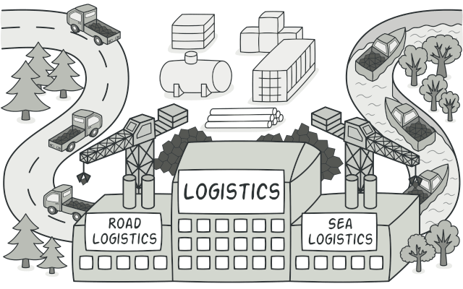
Factory: Class, Object Structural
Intent
Factory Method is a creational design pattern that provides an interface for creating objects in a superclass, but allows subclasses to alter the type of objects that will be created.
Notes:
Intent
Define an interface for creating an object, but let subclasses decide which class to instantiate. Factory Method lets a class defer instantiation to subclasses.
Defining a "virtual" constructor.
The new operator considered harmful

Slide 8
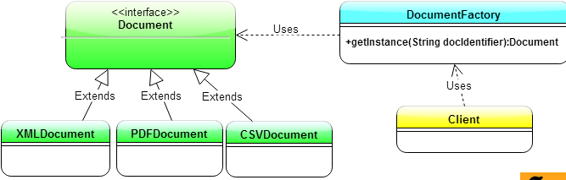
Factory: Implementation
UML class diagram for the Factory Pattern
Notes:
Lets understand the Java Class Diagram for Factory Method Design Pattern in detail to understand how it works –
Interface Document is the base product interface.
XMLProduct, CSVProduct and PDFProduct are concrete implementations of Document interface.
DocumentFactory has a getInstance() method which takes as input the string docIdentifier. Its through the docIdentifier parameter that the Client conveys the message to DocumentFactory regarding which type of document it needs.
DocumentFactory creates the required implementation of Document and returns the object back as type Document. Thus, the getInstance() creates objects of Document’s implementation classes based on client needs. This is how the Factory Method Design Pattern works.

Slide 9
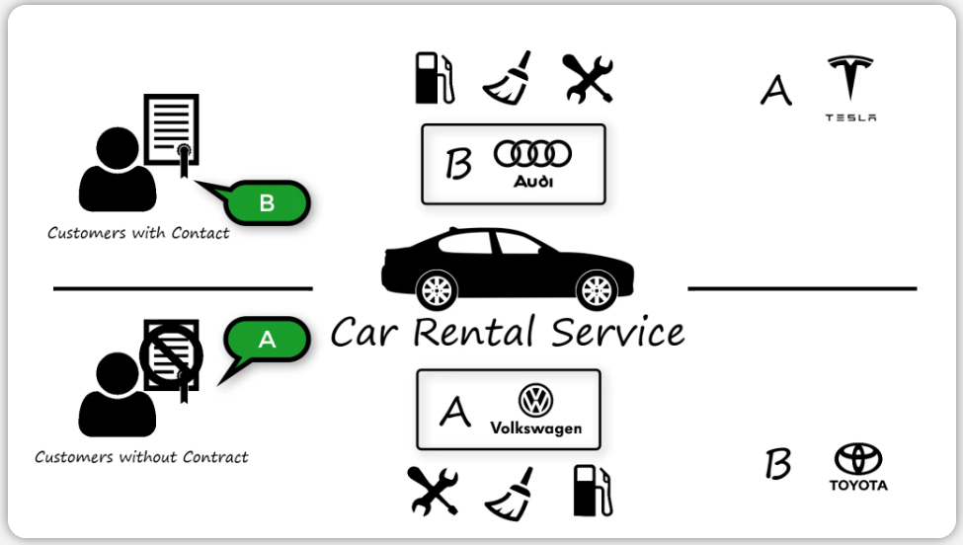
Factory: Implementation example-1
Problem Statement:
Take the example of a car rental service. In this case, the car rental service has two types of customers. Those with a company contract and those without. For each customer type, the rental service has two variations of cars, grade A and grade B.
The owner of the rental service wants a system, which takes in a customer’s requested grade and contract type and outputs the correct car. Additionally, the car should also be checked by a mechanic, cleaned up, and fully fueled.
In other words, this means, that we need a way of creating different variations of a car, which needs to undergo multiple procedural steps before being handed over to the customers.
As a start, let’s try and see how this could be solved without the factory pattern.

Slide 10
Solution
Open Creation
As a beginning, we start by checking whether our customer has a company contract. If so, we retrieve their requested grade of car and runs through the options to see if we have a match.
For this scenario, we have already a Car super-class, which can be extended by all car brands sub-classes (Tesla, Audi, Volkswagen, and Toyota). This allows us to utilize the common methods of the Car super-class to perform a mechanical service check, clean up the car, and put fuel on it.
All of the above mentioned steps have all be accomplished inside the main-method of our system, as can be seen from the code sample below.

Slide 11
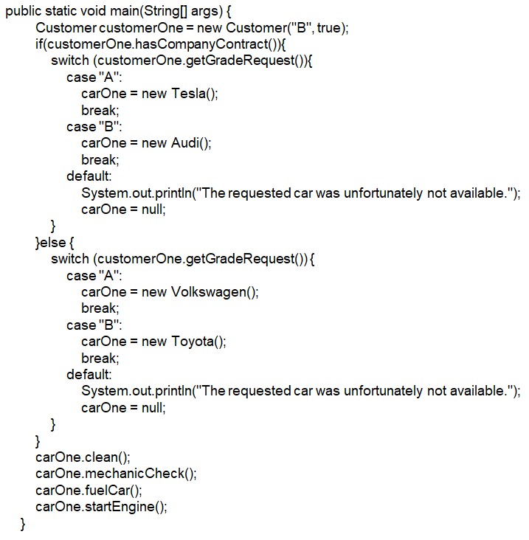
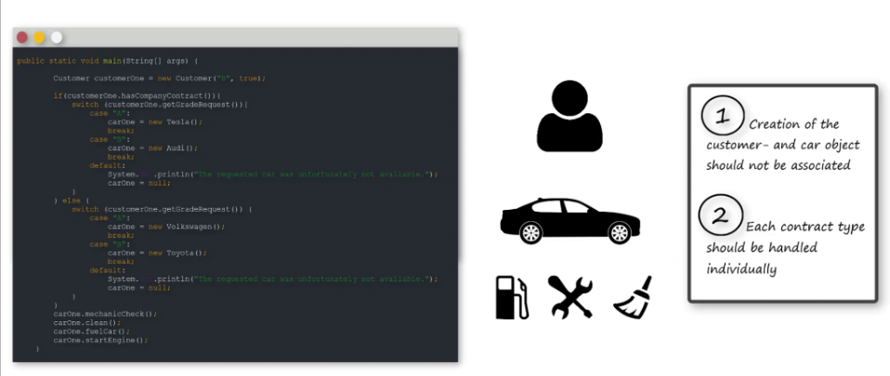
Solution
Although this code sample solves the objective, it has multiple problems.
Firstly, it is not desirable to have all the car selection and preparation logics at the same level of abstraction as where the customer is. We want that kind of logic hidden away from the customer so that they only see the ready and shiny car. In code practice we also want this logic hidden away in its own class, to avoid modifications, while working on other parts of the main-method.
Secondly, we also want each contract type to be handled individually. Let’s say that the rental service one day shut down their company contract agreement. In this case, we want to easily be able to remove the logics related to the company contracts, without jeopardizing changes anywhere else in the system.
With these issues in mind, let’s see what the factory pattern can do for us.

Slide 12
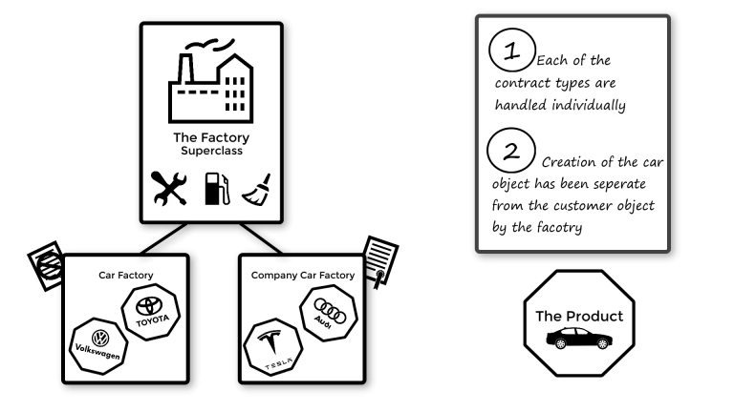
Solution
Concept Of The Factory Pattern
The core concept of the factory pattern is to make a class (the factory), which defines the rules of how to create a specific type of object (the product). The pattern can always be recognized by the create-method.
Notes:
Imagine that we took all the logic from the rental service’s car selection and put it into two separate factory-classes. Both classes would be factories, but one would be related to customers with company contracts, while the other would be related to those without. Individually, these factory-classes are able to figure out what car a customer want. However, they are also aware of the common procedure, which need to take place before the customers get their car. This is because, all the common procedures have been put into the factory-super-class, which both of the car selection factories extend.
Separating the logics in the appropriate level of abstraction, makes the code much easier to read, scale, and maintain.

Slide 13
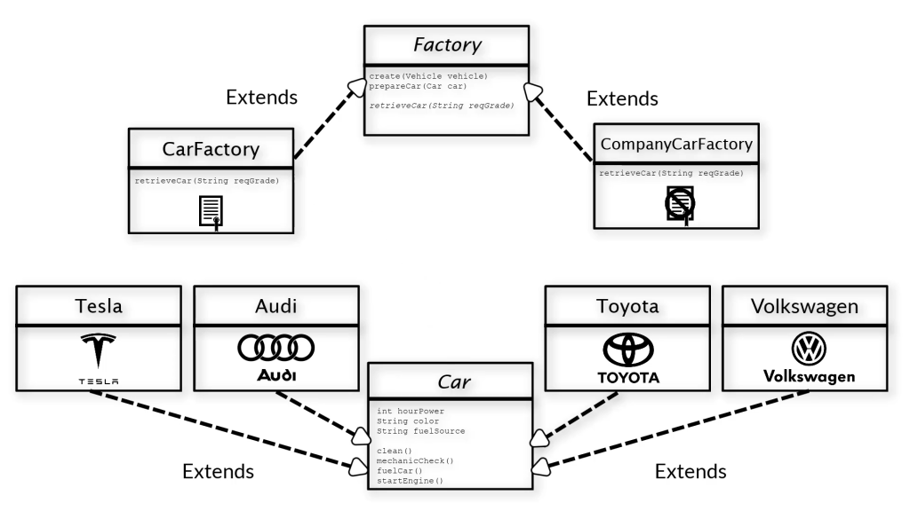
Solution
Class Diagram (UML)
The Factory super-class contains the create-method, which is close to obligatory for any factory pattern. Within this method the initial step is to retrieve the requested car. However, since the super-class does not know anything about the selection logic, it simply states the retrieveCar-method as abstract.
Thereby it requires any class, which extends it, must override the retrieveCar-method and implement its own selection logic.
After having retrieved the car, we come back to the create-method. The remaining part of the method then goes into preparation procedures. This procedure is the same for all cars and we can, therefore, state the steps within the factory super-class.
Notes:
As can be interpreted from the previous sections, we already know a lot about our class structure. As a start, we know that our products are cars and that our factories are the logic and procedures required for providing a car.
As mentioned previously, all car classes (Audi, Tesla, Volkswagen, and Toyota) extend the Car super-class, and both car selection logics (with- /without company contract) extend the Factory super-class.
The Factory super-class contains the create-method, which is close to obligatory for any factory pattern. Within this method the initial step is to retrieve the requested car. However, since the super-class does not know anything about the selection logic, it simply states the retrieveCar-method as abstract. Thereby it requires any class, which extends it, must override the retrieveCar-method and implement its own selection logic.
After having retrieved the car, we come back to the create-method. The remaining part of the method then goes into preparation procedures. This procedure is the same for all cars and we can, therefore, state the steps within the factory super-class.
The Factory super-class does at no point know which specific car (product) it is creating. However, it can rely on the car to have the required methods, since all variations of car classes extend the Car super-class.

Slide 14
Solution
Code (Java)
Link to java implementation

Slide 15
Solution

Slide 16
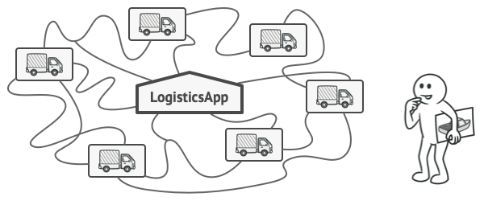
Factory: Scenario example-2
Imagine that you’re creating a logistics management application. The first version of your app can only handle transportation by trucks, so the bulk of your code lives inside the Truck class.
After a while, your app becomes pretty popular. Each day you receive dozens of requests from sea transportation companies to incorporate sea logistics into the app.
Adding a new class to the program isn’t that simple if the rest of the code is already coupled to existing classes.

Slide 17
Factory: Scenario example-2
Great news, right? But how about the code?
At present, most of your code is coupled to the Truck class. Adding Ships into the app would require making changes to the entire codebase. Moreover, if later you decide to add another type of transportation to the app, you will probably need to make all of these changes again.
As a result, you will end up with pretty nasty code, riddled with conditionals that switch the app’s behavior depending on the class of transportation objects.
Solution
The Factory Method pattern suggests that you replace direct object construction calls (using the new operator) with calls to a special factory method.
Don’t worry: the objects are still created via the new operator, but it’s being called from within the factory method. Objects returned by a factory method are often referred to as products.

Slide 18
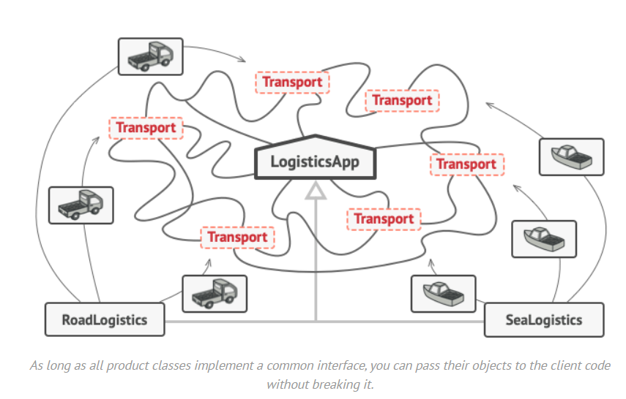
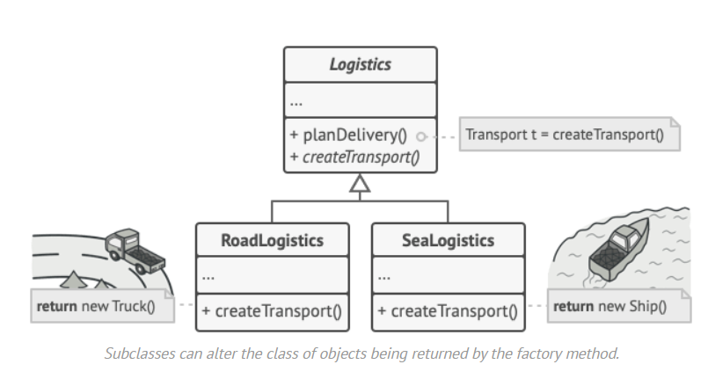
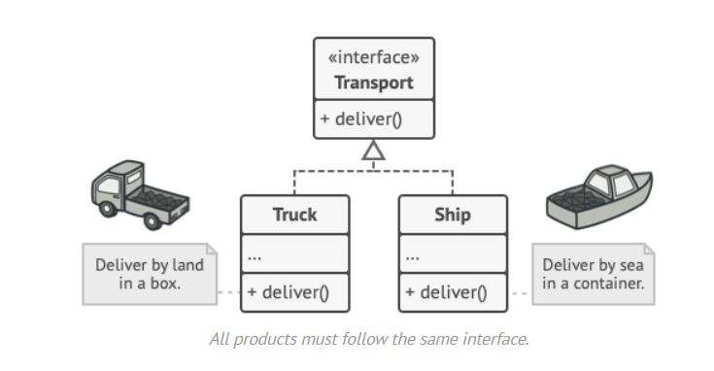
Factory: Scenario example-2
At first glance, this change may look pointless: we just moved the constructor call from one part of the program to another. However, consider this: now you can override the factory method in a subclass and change the class of products being created by the method.
There’s a slight limitation though: subclasses may return different types of products only if these products have a common base class or interface. Also, the factory method in the base class should have its return type declared as this interface.
The code that uses the factory method (often called the client code) doesn’t see a difference between the actual products returned by various subclasses. The client treats all the products as abstract Transport. The client knows that all transport objects are supposed to have the deliver method, but exactly how it works isn’t important to the client.
Notes:
For example, both Truck and Ship classes should implement the Transport interface, which declares a method called deliver. Each class implements this method differently: trucks deliver cargo by land, ships deliver cargo by sea. The factory method in the RoadLogistics class returns truck objects, whereas the factory method in the SeaLogistics class returns ships.

Slide 19
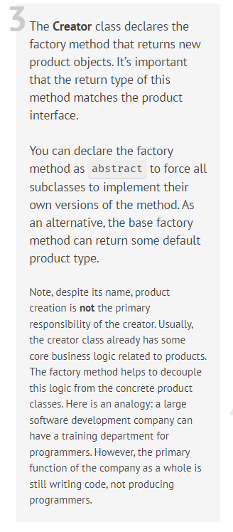
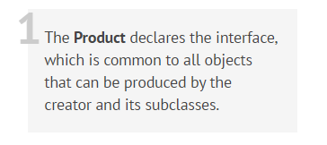
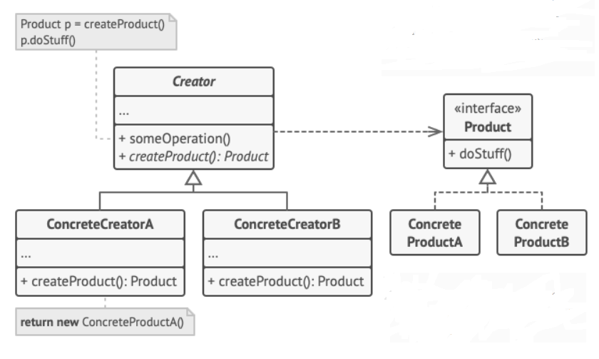
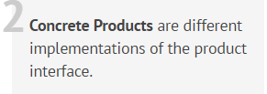
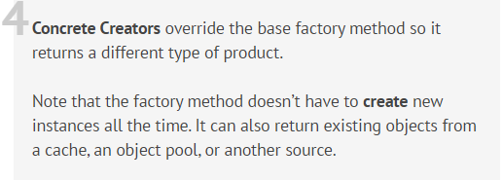
Design Solution

Slide 20
Applicability
Use the Factory pattern when
a class can't anticipate the class of objects it must create.
a class wants its subclasses to specify the objects it creates.
classes delegate responsibility to one of several helper subclasses, and you want to localize the knowledge of which helper subclass is the delegate.
Notes:
Use the Factory Method when you don’t know beforehand the exact types and dependencies of the objects your code should work with.
The Factory Method separates product construction code from the code that actually uses the product. Therefore it’s easier to extend the product construction code independently from the rest of the code.
For example, to add a new product type to the app, you’ll only need to create a new creator subclass and override the factory method in it.
Use the Factory Method when you want to provide users of your library or framework with a way to extend its internal components.
Inheritance is probably the easiest way to extend the default behavior of a library or framework. But how would the framework recognize that your subclass should be used instead of a standard component?
The solution is to reduce the code that constructs components across the framework into a single factory method and let anyone override this method in addition to extending the component itself.
Let’s see how that would work. Imagine that you write an app using an open source UI framework. Your app should have round buttons, but the framework only provides square ones. You extend the standard Button class with a glorious RoundButton subclass. But now you need to tell the main UIFramework class to use the new button subclass instead of a default one.
To achieve this, you create a subclass UIWithRoundButtons from a base framework class and override its createButton method. While this method returns Button objects in the base class, you make your subclass return RoundButton objects. Now use the UIWithRoundButtons class instead of UIFramework. And that’s about it!
Use the Factory Method when you want to save system resources by reusing existing objects instead of rebuilding them each time.
You often experience this need when dealing with large, resource-intensive objects such as database connections, file systems, and network resources.
Let’s think about what has to be done to reuse an existing object:
First, you need to create some storage to keep track of all of the created objects.
When someone requests an object, the program should look for a free object inside that pool.
… and then return it to the client code.
If there are no free objects, the program should create a new one (and add it to the pool).
That’s a lot of code! And it must all be put into a single place so that you don’t pollute the program with duplicate code.
Probably the most obvious and convenient place where this code could be placed is the constructor of the class whose objects we’re trying to reuse. However, a constructor must always return new objects by definition. It can’t return existing instances.
Therefore, you need to have a regular method capable of creating new objects as well as reusing existing ones. That sounds very much like a factory method.

Slide 21
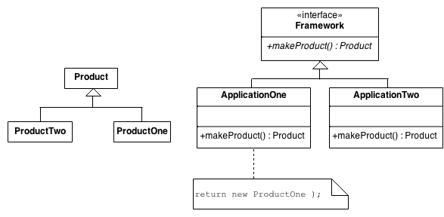
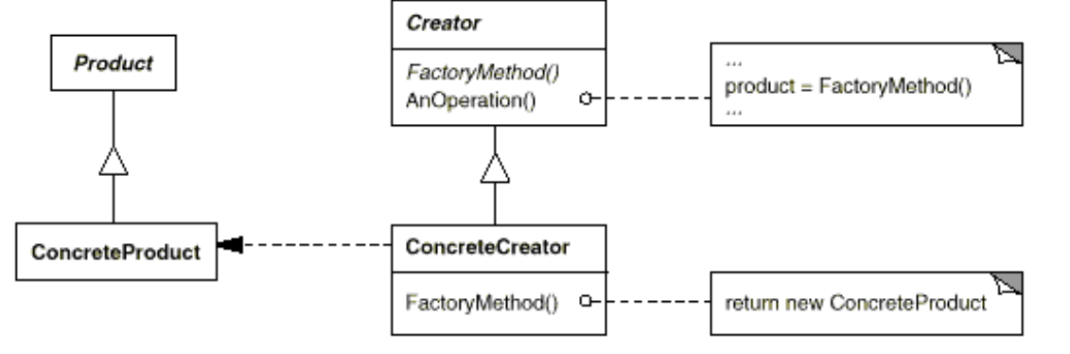
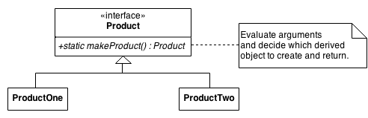
Structure

Slide 22
Participants
Product -defines the interface of objects the factory method creates.
ConcreteProduct - implements the Product interface.
Creator - declares the factory method, which returns an object of type Product.Creator may also define a default implementation of the factory method that returns a default ConcreteProduct object.
- may call the factory method to create a Product object.
ConcreteCreator -overrides the factory method to return an instance of a ConcreteProduct.

Slide 23
Collaboration
Creator relies on its subclasses to define the factory method so that it returns an instance of the appropriate ConcreteProduct.

Slide 24
Consequence
1. Provides hooks for subclasses. Creating objects inside a class with a factory method is always more flexible than creating an object directly. Factory Method gives subclasses a hook for providing an extended version of an object.
2. Connects parallel class hierarchies. In the examples we've considered so far, the factory method is only called by Creators. But this doesn't have to be the case; clients can find factory methods useful, especially in the case of parallel class hierarchies.
Parallel class hierarchies result when a class delegates some of its responsibilities to a separate class. Consider graphical figures that can be manipulated interactively; that is, they can be stretched, moved, or rotated using the mouse. Implementing such interactions isn't always easy. It often requires storing and updating information that records the state of the manipulation at a given time.
Notes:
Factory methods eliminate the need to bind application-specific classes into your code. The code only deals with the Product interface; therefore it can work with any user-defined ConcreteProduct classes. A potential disadvantage of factory methods is that clients might have to subclass the Creator class just to create a particular ConcreteProduct object. Subclassing is fine when the client has to subclass the Creator class anyway, but otherwise the client now must deal with another point of evolution.

Slide 25
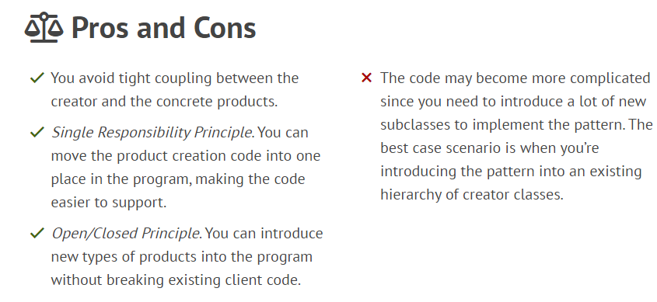
Pros and Cons

Slide 26
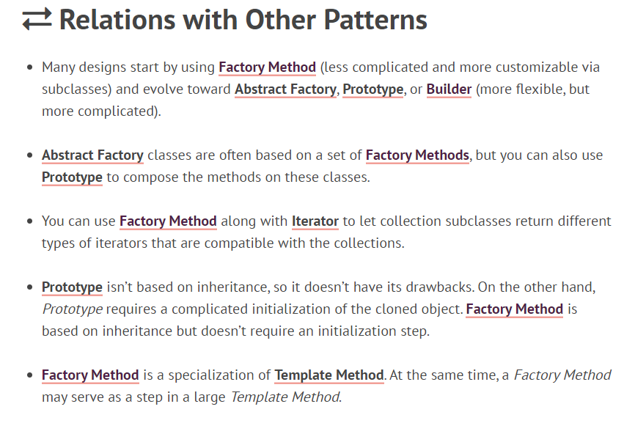
Relationship with other pattern

Slide 27
Issues to consider when using the Factory pattern
1.Two major varieties. The two main variations of the Factory Method pattern are (1) the case when the Creator class is an abstract class and does not provide an implementation for the factory method it declares, and (2) the case when the Creator is a concrete class and provides a default implementation for the factory method. It's also possible to have an abstract class that defines a default implementation, but this is less common. The first case requires subclasses to define an implementation, because there's no reasonable default.
2.Parameterized factory methods. Another variation on the pattern lets the factory method create multiple kinds of products. The factory method takes a parameter that identifies the kind of object to create. All objects the factory method creates will share the Product interface.
3.Language-specific variants and issues. Different languages lend themselves to other interesting variations and caveats. Smalltalk programs often use a method that returns the class of the object to be instantiated. A Creator factory method can use this value to create a product, and a ConcreteCreator may store or even compute this value. The result is an even later binding for the type of ConcreteProduct to be instantiated.

Slide 28
Demo
Link for java program

Slide 29
References
Text Reference
Design Patterns: Elements of Reusable Object-Oriented Software, GOF
Web Reference
https://www.tutorialspoint.com/design_pattern/factory_pattern.htm
https://www.javatpoint.com/factory-method-design-pattern
https://refactoring.guru/design-patterns/factory-method
https://www.geeksforgeeks.org/factory-method-design-pattern-in-java/
https://www.digitalocean.com/community/tutorials/factory-design-pattern-in-java
https://www.baeldung.com/java-factory-pattern
https://sourcemaking.com/design_patterns/factory_method
https://www.scaler.com/topics/factory-design-pattern-in-java/

Slide 30
THANK YOU
Prof Nivedita Kasturi
Department of Computer Science and Engineering
niveditak@pes.edu

